Slide 1
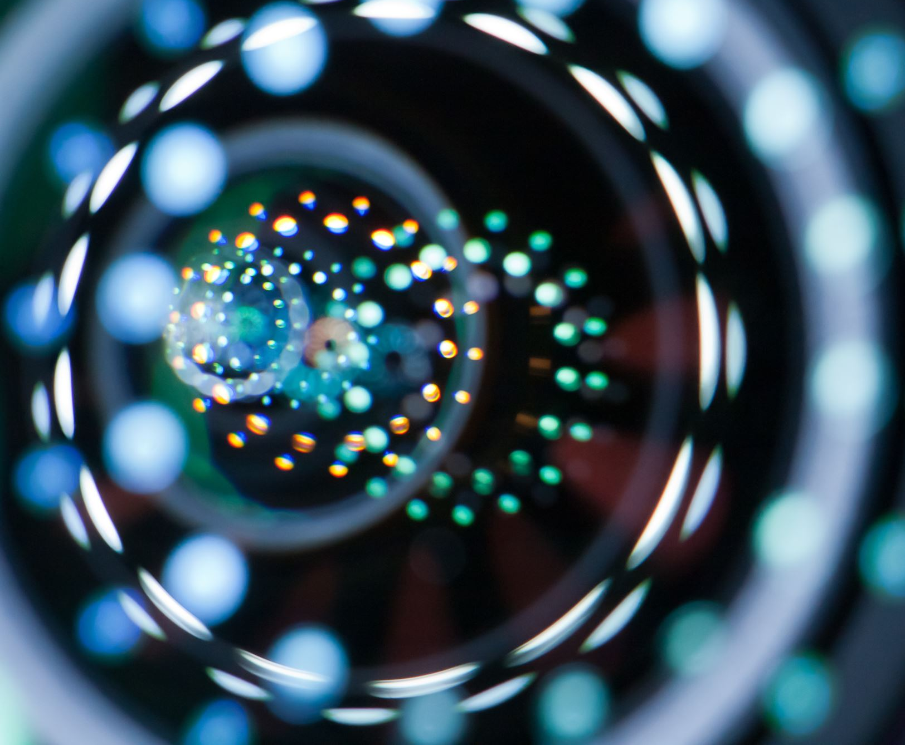
Parallel Image Processing Using OpenMP
Group members:
Mamatha Bugata – Y00860585
Revanth Gopinath Reddy Atla – Y00857087
Yanvitha Gottipati – Y00861602
Faculty Coach:
Dr. Robert A. Gilliland

Slide 2
Introduction Statement
"Parallel Image Processing Using OpenMP" is a project that uses the OpenMP API to accelerate image processing tasks by parallelizing computations across multiple threads. It demonstrates performance optimization for different operations.
The operations include histogram equalization, color correction, resizing, blurring, filtering, and rotation. By distributing these tasks across multiple cores, the program achieves faster execution times, making it ideal for real-time or large-scale image processing.

Slide 3
Background Statement
OpenMP is a widely-used API that simplifies writing multithreaded code for shared-memory parallel processing in C, C++, and Fortran. It provides constructs for developers to efficiently distribute tasks across multiple threads, leading to performance improvements in computationally intensive tasks. In image processing, OpenMP enables faster execution by parallelizing tasks such as filtering, resizing, and color correction, making it a valuable tool for achieving real-time processing and handling large datasets.

Slide 4
Problem Statement
Image processing tasks like resizing, filtering, blur and color correction can be time-consuming, especially for large images. Sequential implementations of these tasks may not make use of all available resources and may result in long execution times.
In addition to being time-consuming, sequential implementations of image processing tasks may also lead to resource inefficiencies
Notes:
. As the size of the image increases, the amount of memory required to store the image and intermediate results also increases. This can lead to issues with memory constraints, and may cause the program to crash or hang.
Moreover, sequential implementations may not make use of parallel processing capabilities, which can result in suboptimal performance. In modern computer systems, parallel processing is becoming increasingly important, and it is essential to take advantage of all available computing resources to achieve maximum performance.
Another issue with sequential implementations is that they may not be scalable. As the size of the image increases, the time required to perform the image processing tasks also increases, which can result in longer execution times. This can be a significant problem for applications that need to process large amounts of data in real-time, such as video streaming or real-time surveillance systems.
To address these challenges, it is important to develop efficient and scalable image processing algorithms that can take advantage of parallel processing capabilities. This requires a deep understanding of the underlying algorithms, as well as the ability to optimize code for performance and scalability.

Slide 5

Solution
The goal of this project is to implement parallel image processing techniques using OpenMP to speed up these tasks and reduce execution time.
Notes:
it is important to carefully manage memory usage and minimize data transfers between processors. This can be achieved through careful data partitioning and management, as well as the use of specialized data structures and caching techniques.
Overall, implementing parallel image processing techniques using OpenMP is an important step towards achieving better performance and reducing execution times. However, to fully optimize performance, it is necessary to consider a range of techniques and approaches and carefully tune the implementation to the specific requirements of the application.

Slide 6
Methodology
List the techniques implemented in the project:-
Color correction
Image resizing
Histogram Equalization
Image blurring
Filtering
Image Rotation
Notes:
For each image processing task (resizing, filtering, color correction), we will first implement a sequential version of the algorithm to establish a baseline performance.
We will then use OpenMP to parallelize the computation of each task, breaking down the image into smaller, equal-sized pieces that can be processed in parallel by multiple threads.
To ensure thread safety and avoid race conditions, we will use appropriate synchronization mechanisms such as locks or atomic operations.
We will also carefully manage memory usage, avoiding excessive data transfers between threads and minimizing the amount of memory required to store intermediate results.
To evaluate the performance of the parallel implementations, we will measure the execution time for a range of input image sizes and number of threads, and compare the results to the sequential baseline.

Slide 7

Methodology
The project uses OpenMP to parallelize image processing tasks by dividing the workload across multiple threads. Functions such as histogram equalization, color correction, resizing, and blurring are optimized for concurrency. OpenMP directives guide the compiler in splitting tasks among threads, enabling faster processing and efficient use of multi-core systems. This approach improves performance and scalability for intensive image processing operations.

Slide 8

Discussion
Performance:
Speed: OpenMP significantly reduced processing times.
Scalability: Improved performance for large images.
Complexity:
Integration: OpenMP was relatively easy to incorporate.
Maintenance: Some additional complexity with parallel code.
Quality:
Functionality: Parallelization maintained image quality across all functions.
Visual Impact: Noticeable changes in corrected images.

Slide 9
Experiments & Output:
Original Image: The unmodified image is loaded for subsequent processing and serves as a reference for transformations.
Corrected Image: The image undergoes color correction using adjustments in brightness and contrast to enhance visual quality.
Resized Image: The image is resized to specified dimensions, allowing for faster processing and reduced storage.
Blurred Image: The image is blurred using a specified kernel size, smoothing details and reducing noise.
Filtered Image: A convolution operation applies a custom kernel to the image, highlighting features or suppressing details based on the kernel configuration.
Histogram Cache Image: The image is equalized using a histogram cache to improve contrast and detail across the entire image.
Rotated Image: The image is rotated by a specified angle around its center, reorienting the image without changing its content.

Slide 10
Color correction
Color correction is a technique used to improve the visual appearance of images by adjusting the colors and brightness levels in the image.
The color correction is applied independently to each pixel in the image, which is an embarrassingly parallel problem.
This means there is no need for synchronization or communication between threads, making it an ideal candidate for parallelization using OpenMP.
Notes:
OpenMP is used for parallelism in the code by setting the number of threads to use and then using the "#pragma omp parallel for" directive to parallelize the outer loop that iterates through the rows of the image.
Performance: The use of OpenMP parallelism can significantly improve the performance of the code by utilizing multiple CPU cores to process the image in parallel.

Slide 11
Image Resizing
Image resizing is a technique used to change the dimensions of an image, either by scaling it up or down.
We will break down the image into smaller, equal-sized pieces that can be processed in parallel by multiple threads.
We used OpenMP to parallelize the computation of bilinear interpolation or bicubic interpolation weights for each pixel in the resized image.
Bilinear interpolation and bicubic interpolation are techniques used for image resizing
Notes:
Bilinear interpolation and bicubic interpolation are techniques used for image resizing, which involve computing new pixel values by interpolating between the original pixel values. This interpolation process can be time-consuming, particularly for large images.
To speed up this computation using parallel processing, we can use OpenMP to divide the image into smaller pieces, or "tiles", which can be processed in parallel by multiple threads. Each thread will be responsible for computing the interpolation weights for a subset of the pixels within its assigned tile.
By breaking down the image into smaller pieces and processing them in parallel, we can take advantage of the processing power of multiple cores or processors, reducing the overall execution time for the image resizing task.
In addition to using OpenMP, we may also need to carefully manage memory usage and avoid data dependencies between threads, such as by using appropriate synchronization mechanisms or avoiding shared data structures. By carefully optimizing the implementation for parallel processing, we can achieve significant speedups in image resizing tasks while maintaining image quality.

Slide 12
Histogram Equalization
Histogram equalization is a technique used to enhance the contrast of an image.
It works by redistributing the pixel intensities in an image to cover the full range of intensity values.
The goal of histogram equalization is to achieve a uniform histogram, where each pixel intensity has an equal probability of occurrence.
Notes:
This function performs parallel histogram equalization on an input color image. It first converts the input image from BGR to YUV color space using OpenCV's cvtColor function. It then splits the YUV channels into separate cv::Mat objects and performs histogram equalization on the Y channel. The function uses OpenMP to parallelize the loop that iterates over each pixel in the Y channel. After the histogram equalization, the modified Y channel is merged back into the YUV channels and the image is converted back to the BGR color space using the cvtColor function. The output of the function is the equalized color image in BGR color space.

Slide 13
Image Blurring
Image blurring is a technique used to reduce noise and details in an image by averaging the neighboring pixel values.
The blurring is performed by iterating over a square kernel centered at each pixel, summing the values of the neighboring pixels, and then dividing by the total number of pixels in the kernel.
The operation is independent for each pixel (except for the border pixels), it is an embarrassingly parallel problem, making it an ideal candidate for parallelization using OpenMP.
Notes:
OpenMP is used to parallelize the nested loops that process the image pixels and helps distribute work among multiple threads.
By using OpenMP, the pixel processing workload is distributed among multiple threads, which can lead to a significant speedup in the image blurring process, especially for large images or when running on systems with multiple CPU cores.

Slide 14
Filtering
Filtering involves designing a specific kernel to achieve a desired effect on an image.
The filtering function is called for each pixel in the input image. This function should be implemented according to the desired filter behavior.
Filtering is a technique used in image processing to modify or enhance an image by convolving it with a filter kernel.
The filter kernel is a small matrix of numerical values that is applied to each pixel in the image to produce a new pixel value.
Notes:
Filtering is a technique used in image processing to modify or enhance an image by convolving it with a filter kernel. The filter kernel is a small matrix of numerical values that is applied to each pixel in the image to produce a new pixel value.
The convolution process involves sliding the filter kernel over the image, computing a weighted sum of the values in the kernel for each pixel location, and replacing the original pixel value with the computed sum. This process can be time-consuming, particularly for large images or complex filter kernels.

Slide 15
Image Rotation
The Image Rotate function rotates an input image by a given angle using parallel processing with OpenMP.
The function uses OpenMP to parallelize the loop that iterates over each pixel in the input image.
For each pixel, it computes the corresponding new position after rotation using the rotation matrix and checks if the new position is within the bounds of the input image. If so, it copies the pixel value from the input image to the corresponding position in the output image.
Notes:
This function performs a rotation operation on an input image using the OpenMP library to parallelize the loop. The input image is passed as a cv::Mat object, along with a rotation angle in degrees and the number of threads to use for parallel execution. The output of the function is also a cv::Mat object that represents the rotated image.
The function first computes the center point of the input image and the corresponding rotation matrix using the cv::getRotationMatrix2D function from OpenCV. It then creates an output image with the same size and type as the input image and initializes it to all zeros.

Slide 16
Conclusion
In conclusion, we have presented an in-depth exploration of an image processing application that leverages the power of OpenMP to parallelize a diverse array of image processing techniques, including color correction, image resizing, image blurring, filtering, image rotation and histogram equalization.
By taking advantage of parallelization, our application demonstrates significant performance improvements compared to traditional sequential implementations.

Slide 17
Contribution of Team members:
Revanth Gopinath Reddy Atla:
Histogram Equalization and Color Correction: Implemented parallel histogram equalization and color correction functions to enhance image quality and contrast.
Testing and Optimization: Focused on testing the implementation and optimizing performance for efficient parallel execution.
Mamatha Bugata:
Resizing and Blurring Functions: Took charge of parallelizing the image resizing and blurring functions for faster and smoother image transformations.
Documentation and Code Comments: Provided clear documentation and comments to support the parallel code for ease of maintenance and understanding.
Yanvitha Gottipati:
Filtering and Rotation Functions: Developed the parallelized filtering and rotation functions to apply advanced image transformations and feature enhancements.
Integration and Presentation: Worked on integrating different functions and preparing the final output for presentation and analysis.

Slide 18

Thank You

